Slide 1

More Advanced Data Structures in LabVIEW
Brian Kindinger
Systems Engineer (CLA)

Slide 2
Agenda
Introduction
LabVIEW Native Data Structures
Applications of Advanced Data Structures
Priority Queue
Route Minimizing
Path Discovery
Content

Slide 3
Introduction
In the context of computer programs Data is a unit of information.
A Data Structure is a particular way of storing and organizing data.
Notes:
Basically read the slide. Just a good starting point.

Slide 4

LabVIEW Data Structures
Simple
Linked List
Tree
Graph
Advanced
Notes:
LabVIEW comes with native data structures. The simplest data would be standard controls like the Double or Boolean. We build upon the basic data types to make Arrays of Doubles and Booleans. This would be our first basic data structure in that, we organize the data into a contiguous memory space. Strings are similar in that they are characters lined into a row. Clusters are custom combinations of the primitive data types. Queues are a data structure used to synchronize data transfer. Variant is a data structure that all other data types can be transformed into. Finally a LabVIEW Object is a data structure (cluster) with the concepts of encapsulation and inheritance added.
But that about ends the Native Data Structures. Which leaves a hole for some more advanced and customized data structures like the linked list, Tree, or Graph. Those three data structures are what we will be discussing for the rest of the presentation.
Note: This slide shows the blending of Data and Data Structures.

Slide 5


Native Data Structures – Variant Attribute
Variants have a little known feature called attributes
Used to store random data with the variant
Very interesting implementation under the hood

Slide 6
Native Data Structures – Variant Attribute
Variant
Data
Attributes (Binary Tree)

Slide 7
Native Data Structures – Variant Attribute
Incredibly fast lookup and insert
Out of box way to search for data
Easy to wrap for a customized API

Slide 8

Priority Queue
LabVIEW Queue can enqueue in the front and back.
How and why might we want to insert in the middle?

Slide 9
Priority Queue
Commands
Control
Processing Queue
Log
Process
Abort
Heartbeat
Notes:
Move slower, insert in the middle, increase

Slide 10
Priority Queue via Linked List
A sequence of data “nodes” linked together
Linked List
NodeA
NodeB
NodeD
NodeC
Front
Back
Arrows indicate “links” between the nodes. Links are used to navigate through Linked List.
Notes:
A linked list is a sequence of data “nodes” linked together. Each node is simply a data point the added information of who their next and previous nodes are. A list has a front and a back.
The job of the linked list is two fold:
Encapsulate the nodes. Similar to how a cluster encapsulates basic data types.
Coordinate the assignment of links. Even though the nodes contain the links to next and previous, they are assigned the information from the linked list.

Slide 11


Priority Queue via Linked List
Linked List
Node A
Node B
Node C
Root
A Structure that organizes Nodes of Data together by linking them sequentially like a Chain
Notes:
Data value references were a LabVIEW feature introduced in LV 2009. They provide a way to access data in LabVIEW by reference, while still following data flow principles. By reference is necessary to have a bidirectional linked list (a.k.a Node A knows how to find Node B by its Data Value Reference “Next”, and Node B knows how to find Node A by its Data Value Reference “previous”).
Thus we can navigate or search from node to node by a system of links in a linear fashion.

Slide 12
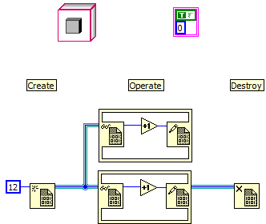

Review of DVRs and LVOOP
Object
“Special Cluster”
Data Value Reference
Notes:
Sequence structure on bottom picture

Slide 13




Priority Queue Implementation
Generic Linked List Operations
Search
Insert
Remove
Priority Queue
Create Priority Queue
Insert Message
Remove Message
Destroy Priority Queue
Notes:
We are going to solve the priority queue application via a linked list, but it would be nice to separate the generic linked list operations from the specific priority queue operations.
We do so by making two base classes, Linked List and Linked List Node. Then the specific implementation for Priority queue and Priority queue Message are a new class that inherits from the previous.
P Queue. And mention inheritance in presentation.

Slide 14
Priority Queue Implementation
Demo (Search Linked List)
Notes:
Don’t bother with performance.

Slide 15
Route Minimizing (Traveling Salesman)
A
B
D
C

Slide 16
Route Minimizing (Traveling Salesman)
[A]
A
[AB]
[AC]
[AD]
B
C
D
[ABC]
[ABD]
[ACB]
[ACD]
[ADB]
[ADC]
E
F
G
H
I
J
[ABCD]
[ABDC]
[ACBD]
[ACDB]
[ADBC]
[ADCB]
K
L
M
N
O
P
Used in logistics, automated soldering, machine planning
Factorial solutions (n!)
Notes:
Route minimizing is the process of reducing the cost of procedure based on a fixed number of decisions. The most famous route minimizing problem is the traveling salesman. The concept is you have a salesman who starts in City A. He needs to get to Cities B, C, D to visit his customers, and he wants to find the most efficient travel plans. Other applications include logistics, automated soldering, and machine planning.
Based on the information of we start in City A, and we need to get to Cities B, C, D we can diagram how we might solve the problem. Lets take a closer look.
If we take each set of cities, and replace them with nodes, the structure that best represents the problem is a tree.

Slide 17

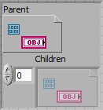
Tree Implementation
Tree
A
B
F
C
D
E
G
Notes:
Trees are similar to linked lists with a slight twist. Instead of previous and next nodes, they have a parent and children. The parent node is the node above, and the children nodes are the nodes below.
As such, each node has a Data Value Reference to its parent node, and an array of Data Value References that go to it’s children.
Once again the tree will be a LabVIEW class that encapsulates the Tree Nodes.

Slide 18
Tree Implementation – Searching
Tree
Methods
Depth
Breadth
Heuristic\Best First
A
B
F
C
D
E
E
G
Notes:
The largest difference between linked lists and trees is how we search through the data structure. In a linked list we could go in a linear fashion from node to next node. In a tree we have diverging paths. As such there are different searching methods, with different advantages.
Depth-based search. The pattern is to always be moving to the bottom of the tree. If we reach a deadend, backtrack slightly and try another route. This is good if we know our tree has a bottom, there are multiple solutions, and we are just trying to find one as fast as possible.

Slide 19
Tree Implementation - Searching
Tree
Methods
Depth
Breadth
Heuristic\Best First
A
B
F
C
D
E
E
G
Notes:
Breadth-based search. Focus on searching the nodes closest to the root before moving down the tree. Good if we don’t know if there is a bottom to the tree, or if a solution is not necessarily at the bottom.

Slide 20
Tree Implementation - Search
Tree
Methods
Depth
Breadth
Heuristic\Best First
A
B
F
C
D
E
E
G
Heuristic Search uses knowledge of the trees structure to reduce the number of nodes we must search through.
Notes:
Heuristic\Best First Search. A search where we apply the knowledge of the tree to produce faster results. The search is only as good as our heuristic.
A final note on solutions. A search can have more than one solution. We can search for the first solution we find (which is fastest), or we can exhaustively search the tree to find the best solution. Exhaustive search typically take a VERY long time.

Slide 21
Tree Implementation – Search (Depth)
Tree
OPEN
A
A
B
B
F
F
C
C
D
D
E
E
G
Place root node in OPEN
Check for goal node (if goal stop)
Expand search to children
4. Add children to the front of OPEN
5. Repeat step 2
Notes:
Walk-through the steps on the slide.

Slide 22
Tree Implementation – Search (Heuristic)
Tree
OPEN
A
A
0
B
F
B
H
28
47
Evaluation F sets the order
X
C
C
D
D
E
E
G
F
40
38
28
Place root node in OPEN
Check for goal node (if goal stop)
Expand search to children
Evaluate each node
5. Add children to OPEN sorting by lowest score first
6. Repeat step 2
Notes:
Walk-through the steps on the slide. Need to talk about
There is some sort of F that defines if we are doing better or worse.
The goal is a good enough

Slide 23
Route Minimizing – Search (Heuristic)
A
B
C
Evaluation F =
(A to B to C to I to E) +
nearest neighbor(D, G, H)
D
E
I
H
G
Notes:
So let’s make a heuristic for the route minimizing . G is our cost to make it to this goal so far. In this example that would be the distance of A to B to C to F to E.
The difficult part is making a function for finding the estimated distance to our goal. There are many white papers on how to do that best. I took the easy road and picked a function that chooses the nearest neighbor path.

Slide 24
Route Minimizing
Demo

Slide 25
Path Discovery
A
B
Notes:
The final application is a common mobile robotics problem. The goal is to get from point A to point B without running into an obstacle.
We start by placing a grid on the map. This creates what is referred to as a occupancy map. Each square or cell is a discrete location we can move into. Cells with obstacles are considered to be invalid cells. The goal is to find the least number of cells to enter.

Slide 26
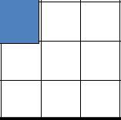

Path Discovery via Graph
Each square is a Node, except squares that have obstacles
Each adjacent node is linked
A is the Start node
B is the Goal Node
Searching is very similar to a Tree
A
B
Notes:
Each cell becomes a node. That node is linked to 8 other adjacent nodes. A is the starting node, and B is the goal node. In this way it becomes very similar to tree, with a large exception that we will cover.

Slide 27
Graph Implementation
Graph
OPEN
A
B
C
D
CLOSED
E
F
Each node has an array of DVRs to its adjacent nodes.
OPEN is the list of nodes to search
CLOSED is a list that keeps track of the nodes we have already searched
Notes:
Each node has an array of Data Value References to is adjacent nodes. These are simply called Linked nodes. There is no concept of parent or children, just linked nodes that the graph uses to navigate through the structure. Similar to the tree we have a list called OPEN which keeps track of the nodes we are searching through. Unlike the tree, when we move a node from OPEN we place it on CLOSED. This prevent us from opening the same node twice.

Slide 28
Path Discovery
Demo

Slide 29
More Applications
Linked List
Jagged Arrays
Hash Tables
Tree
System Representations
Binary Search Trees
Linguistics
Graph
Defect Detection
Image Processing
Bonus: Sudoku Solver

Slide 30
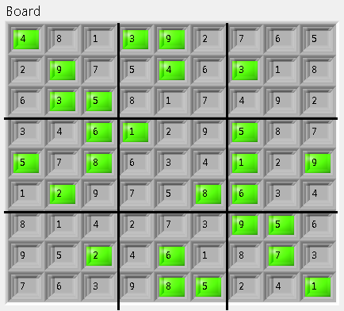
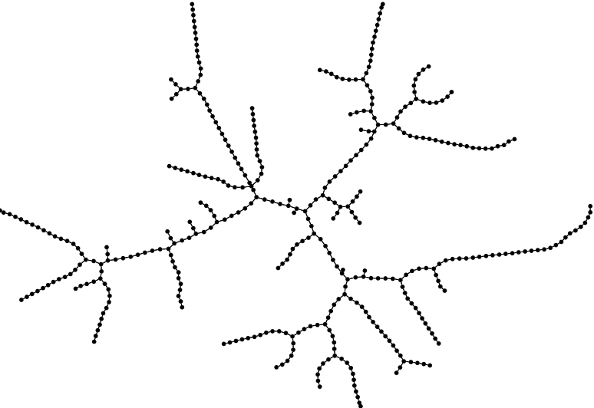
Sudoku Solver - Hard

Slide 31
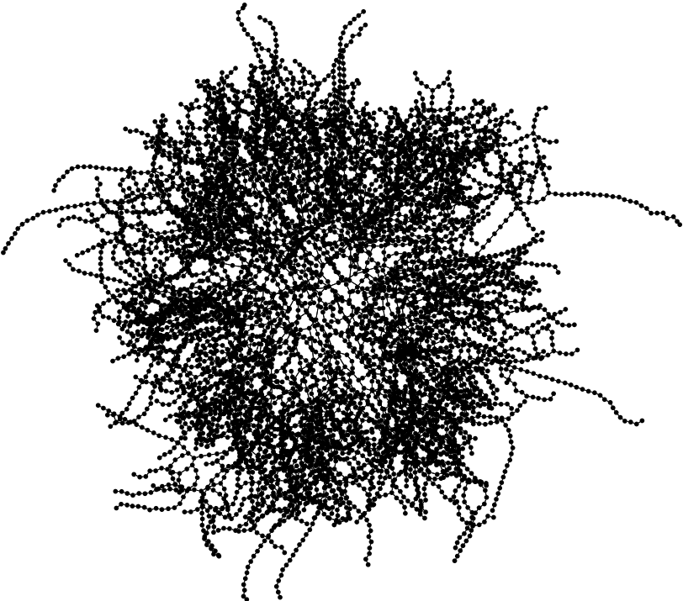
Sudoku Solver - Ultimate

Slide 32
Content
Advanced Data Structures in LabVIEW
http://decibel.ni.com/content/docs/DOC-12668
Or search Lavag.org for “Data Structures” to find the LAVA forum discussion

Slide 33

Questions

Slide 34

Alliance Partner Network 20th Anniversary Celebration
Join us for an evening of drinks, music, networking, and a celebratory toast by Dr. James Truchard at 5:30 p.m. in the exhibition hall.

Slide 35
Linked List Operations
Linked List
Iterator
NodeA
NodeB
NodeC
Operations
Search
Insert
Remove

Slide 36
Linked List Operations
Linked List
Iterator
NodeA
NodeB
NodeD
NodeC
Operations
Search
Insert
Remove

Slide 37
Linked List Operations
Linked List
Iterator
NodeA
NodeB
NodeC
NodeD
Operations
Search
Insert
Remove

Slide 38


Linked List in LabVIEW
How to make a generic Linked List that can be extended to most applications?
Links are essentially pointers. There are no pointers in LabVIEW.
LabVIEW Classes = Dynamic Dispatch
Data Value References are the fastest way to access data by-reference.

Slide 39
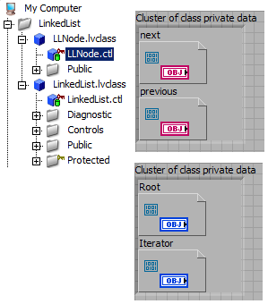
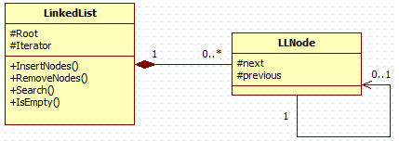
Linked List in LabVIEW

Slide 40
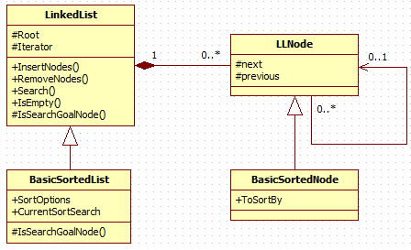
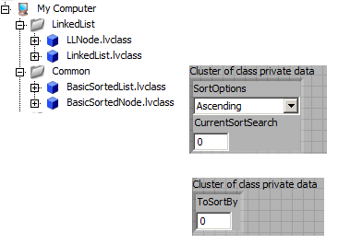
Linked List in LabVIEW
BasicSortedList and BasicSortedNode extends the LinkedList functionality to sort by ascending\decending numbers.

Slide 41
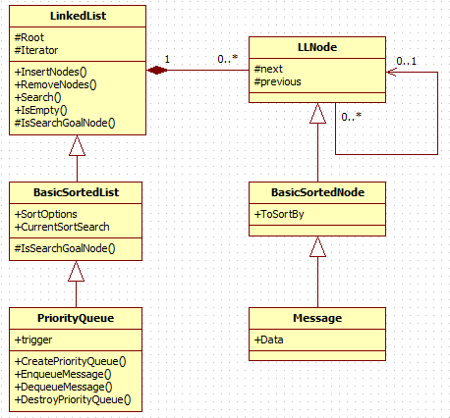
Linked List in LabVIEW
A Priority Queue is a Queue that inserts nodes based on their priority or number.

